Slide 1

Welcome To
Year 6H
By SOBTONE

Slide 2
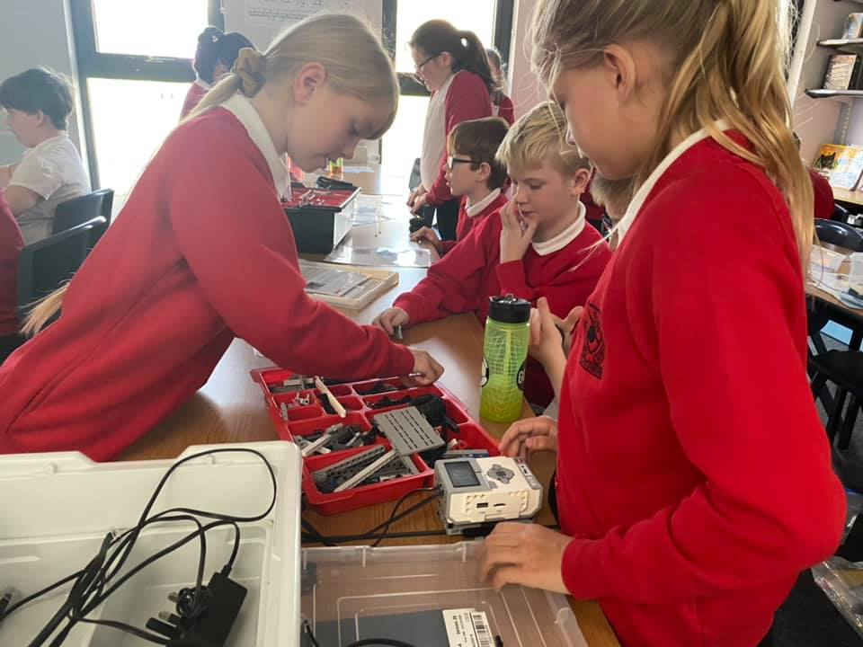
Welcome
Headteacher: Mrs Rushton
SENDCo: Amy Merritt
Year 6H Teacher: Miss Head
Support Staff: Mrs Watson
Miss Stephenson

Slide 3
School Day
Breakfast Club:
Please book beforehand using Arbor:
7:45-8:45= £1.50
8:15-8:45= 75p
Registration: 8:45 (school gates open at 8:35)
Morning Lessons: 8:45-12:20
Afternoon Lessons: 13:00-15:15
Day ends: 15:15
After-School Clubs and Wrap-Around:
Please book beforehand using Arbor
3:15-5:15pm= £5 3:15-4:15pm= £2.50
Lunch: 12:20-13:00 using Arbor
Our lunch menu runs on a 3 week cycle.
These can be ordered from home.
The cost of meals are as follows:
£2.70 per day
£13.50per week
Option of a hot meal, deli bar and jacket potatoes.
Children can bring their own packed lunch.

Slide 4
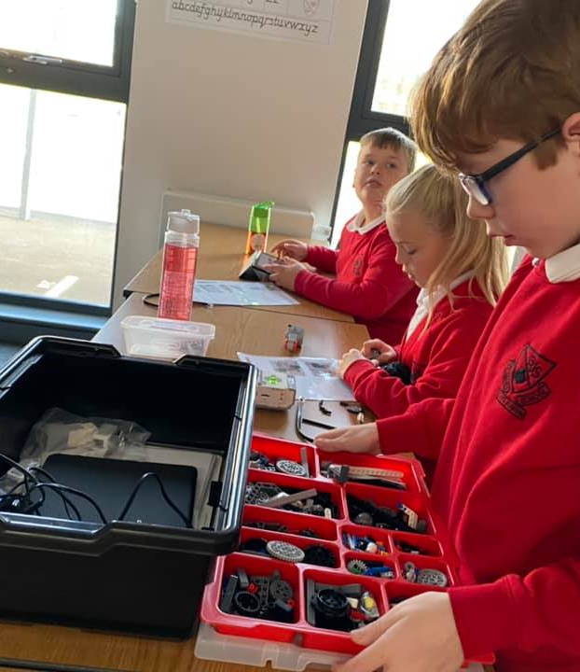
Uniform
Grey or Black skirt / pinafore
Grey or Black trousers
White polo shirt
Red sweatshirt / cardigan
Dark flat sensible shoes, black trainers
Summer Term alternatives or as above:
Red / white checked dresses
Grey or Black school shorts
Earrings- one pair of studs, no hoops
Mobile Phones
New Government guidelines state that mobile phones should not be brought into school unless absolutely necessary. If your child must have a phone in school, parent/carers, must complete a form which is available from the school office.

Slide 5
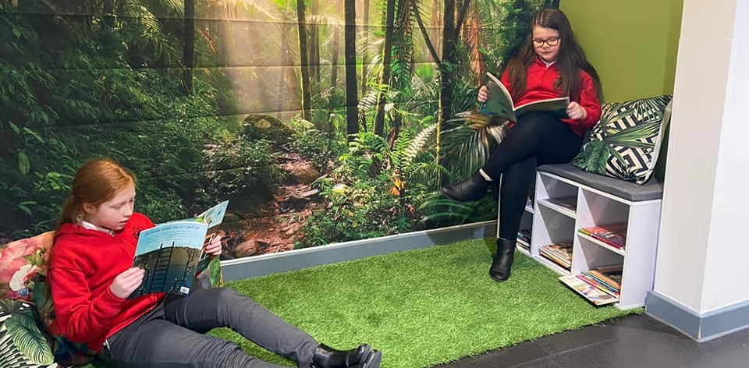
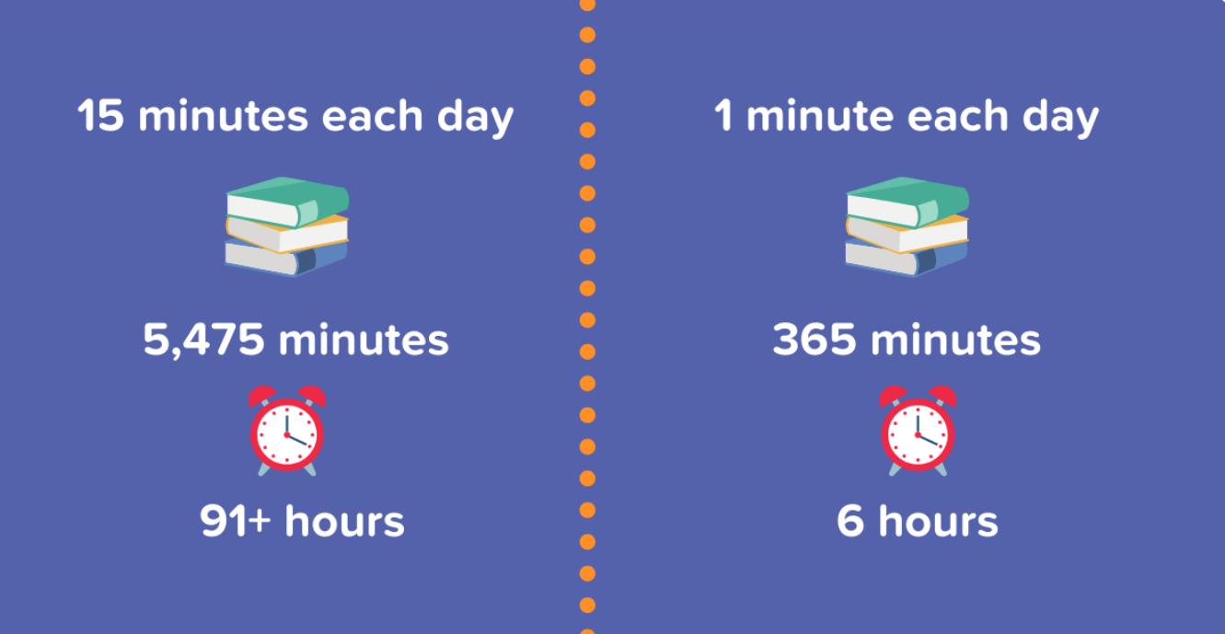
Reading
Changing Books
Reading Records
School Library choices
Guided reading in class
Independent reading in class
Homework-Set on Friday…collected on Thursday
English (comprehension task, EPGs, research, note making)
Maths (basic recall, SATs style questions, recapping the current learning objective in class)
Reading (minimum 4 x per week-aloud/independently at home)
Times Tables-Rockstars
Spelling Shed (spellings are set weekly to practise for a test Friday)

Slide 6
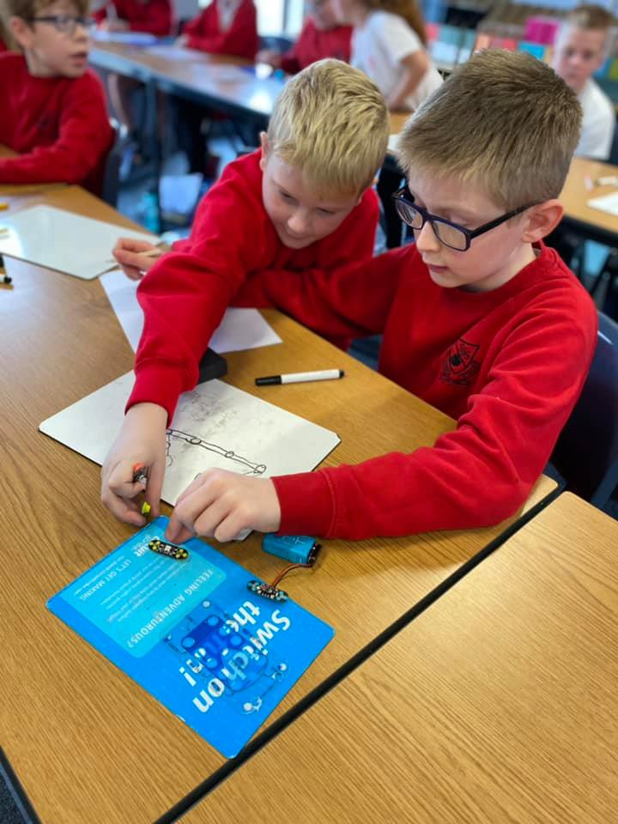
Attendance
School attendance is important. The school’s target is 96% attendance each academic year.
Illness and appointments
If your child will be absent, due to illness or appointment, you must contact the school office before 9am.
Holidays
Schools are no longer able to grant any leave for holidays during term time. However, if you are planning to take your child out of school it is essential that you let us know. Please collect an absence request form from the school office.

Slide 7
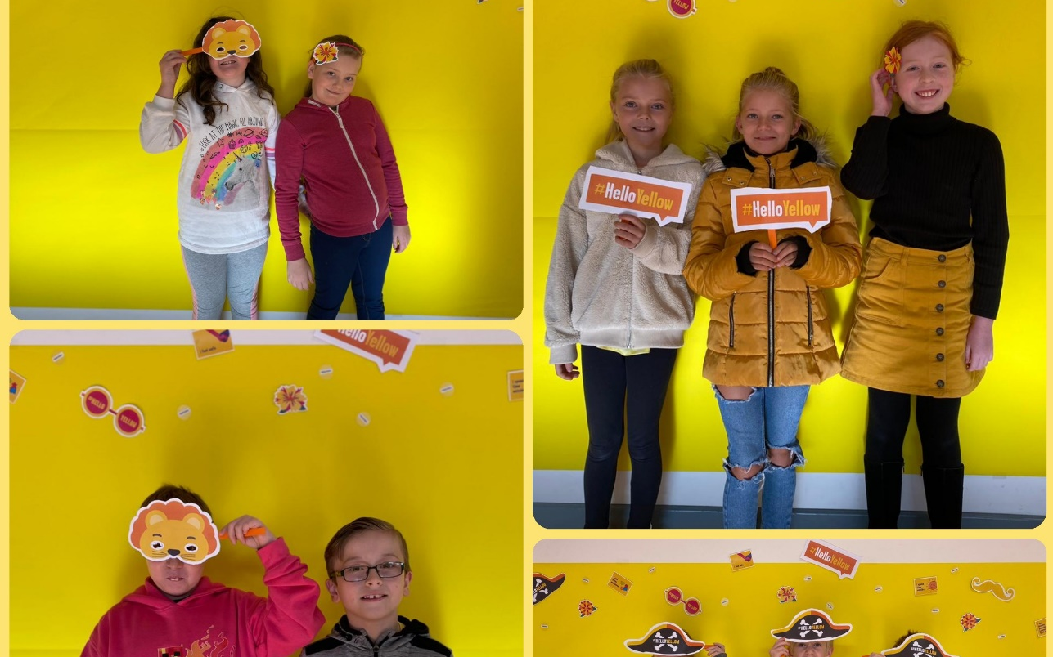
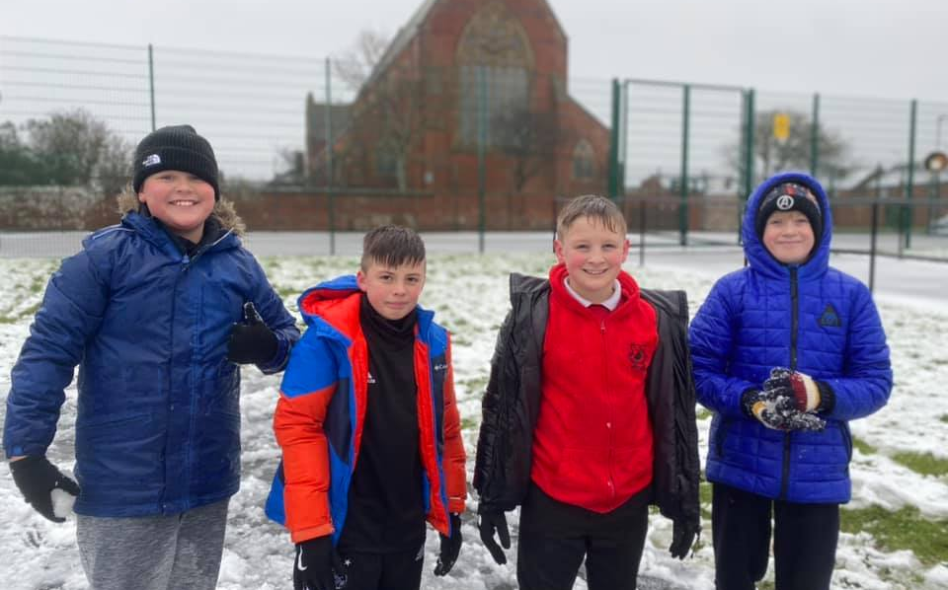
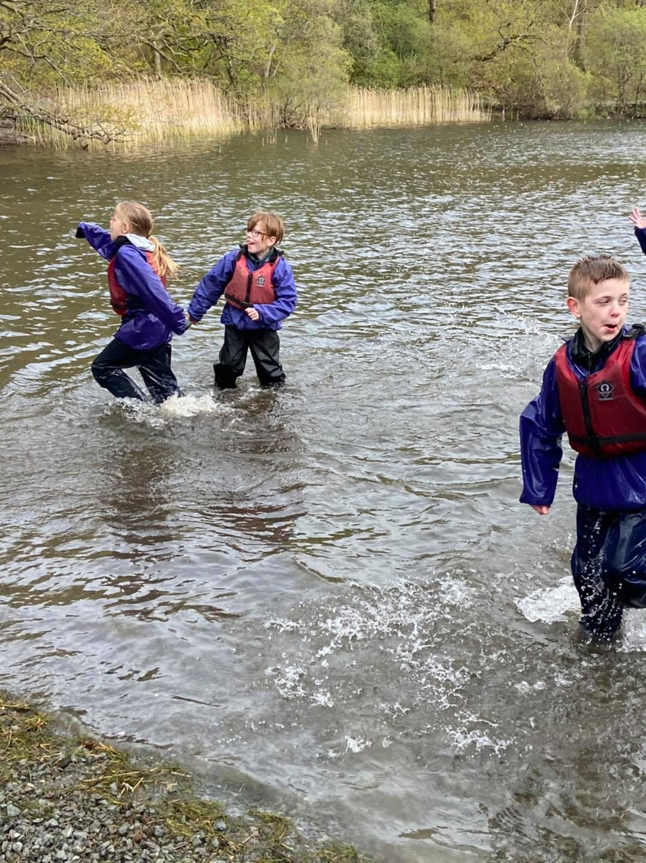
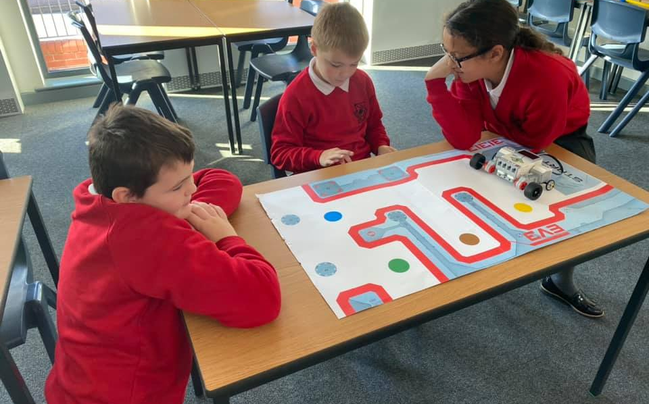
PE
Two days of PE per week.
Autumn term 1 PE days will be Tuesday and Friday for 6H.
Kit:
Red t-shirt
Black joggers
Black shorts
School zoodie/school sweatshirt/school tracksuit top.
Swimming-Summer TBC
£1.50 per week paid through Arbor (voluntary payment)

Slide 8



SJS Ethos
Show me five:
We take care of each other.
We listen and follow instructions.
We are honest.
We respect each others’ property.
We always try our best.
Any problems or questions?
Do ask for us by calling school, emailing the office or speaking to us at the end of the day.
office@stjamesjun-bif.cumbria.sch.uk

Slide 9
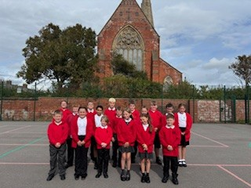
Rewards!
There are many ways the children are praised for their efforts inside and outside of the classroom.
We have stickers and Value Tokens; praise certificates and praise assemblies weekly; positions of responsibility in class and for the wider school community; positive messages home from the school staff team.

Slide 10
School Sanctions
1 | Green | Warning Make reference to which of the rules it refers too.
2 | Amber | Child is moved to amber Make reference to which of the rules it refers too.
3 | Red | Dinner-time Detention 10 minute detention and reflection activity in the practical room. 12-12:10: LS 12:20-12:30: US Text is sent home.
4 | Red | Time-out is given and child is asked to take time to calm down and reflect. Text is sent home.
5 | Red | Removal from class. Text is sent home.
1 | Warning Make reference to which of the rules it refers too.
2 | Amber | Amber Card given Make reference to which of the rules it refers too. Warn the child of the red card and the consequence that brings.
3 | Red | Red card given 10 minute-out given. If it happens at the end of dinner then child sits in 10-minute detention the next day. Text is sent home. Member of staff is informed.

Slide 11
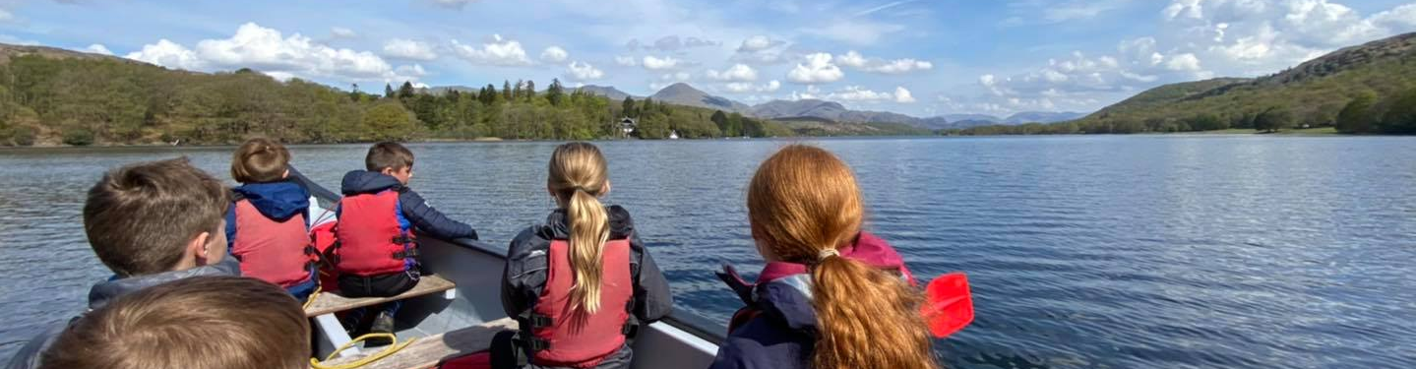
We look forward to an amazing year together!
CARE. SHARE. RESPECT.

